Slide 1
Hepatitis Detector
-Predict the presence of Hepatitis
Dewayne Eason
Linh Nguyen
Geoff King
Haroon Ahmad
Raaghavan Krishnamurthy

Slide 2


The Core Message
The message conveyed from the Project?
HISTORY by HAROON
PLACE where we type in the core message by HAROON
FACTS and Why we Decided to Choose this Project by HAROON

Slide 3
The Motivation!
Questions, that lead us to the research
How ML can help diagnose hepatitis in Advance?
What about a tool, which helps doctor to take care of the prediction, before taking next action?
Hepatitis Detector

Slide 4
The Data Set
The fuel to our analysis and model
Openml.org
Data Points
Data Donated by
https://www.openml.org/d/269
1 Million
Carnegie Mellon University
Categorical
(15)
Continuous
(4)
Classifier
(1)
Definition
Data
Feature Variables
Output

Slide 5




Process Pipeline
The Analysis Flow, for the final output
Interactive Viz
ML Algorithm
SVM
Tabpy
1 Layer NN
2 Layer DNN
Random Forest
< 92% Accuracy
+93% Accuracy

Slide 6
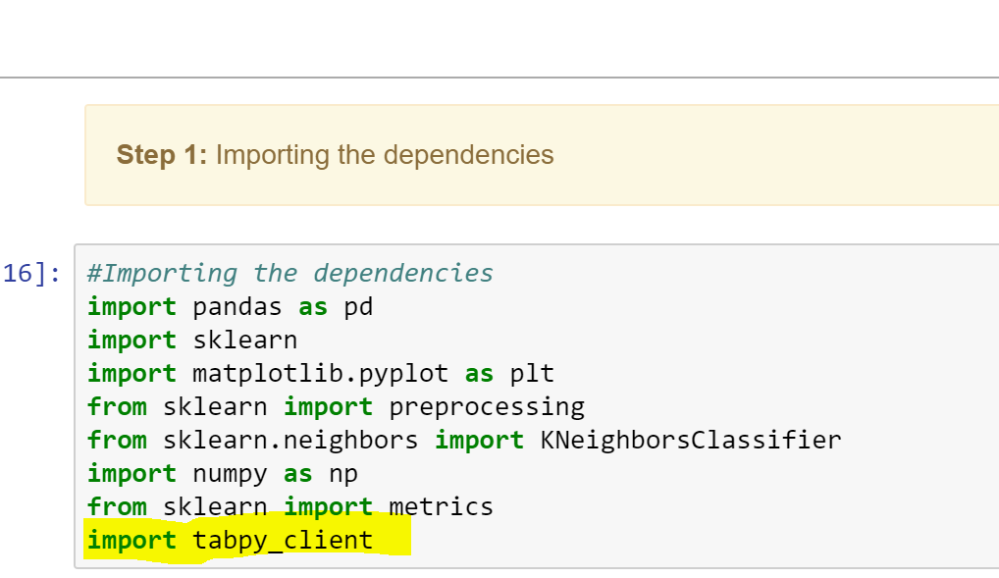
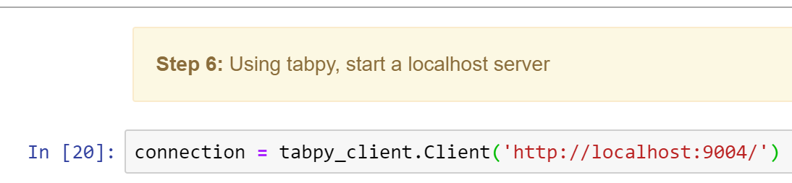
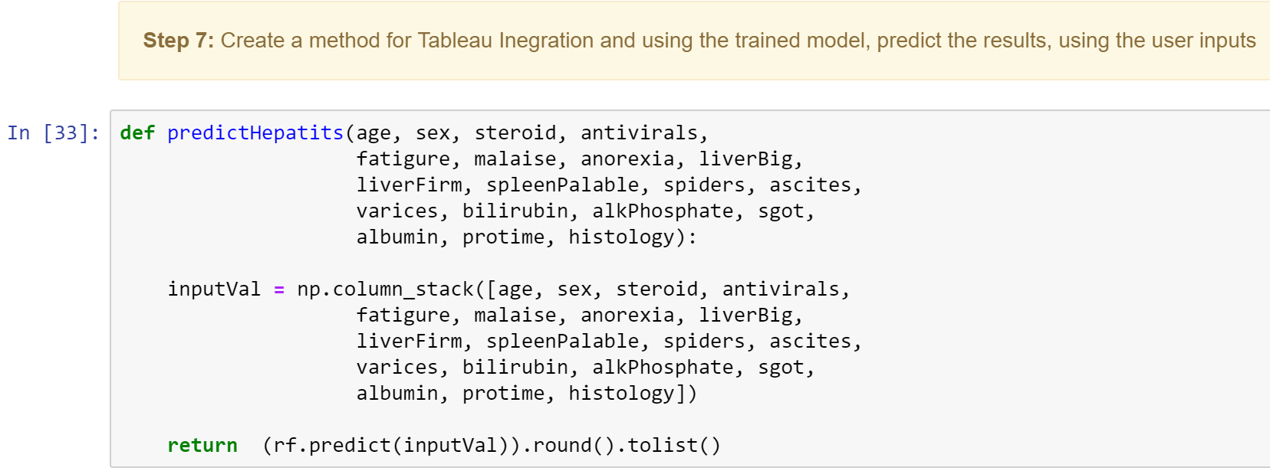
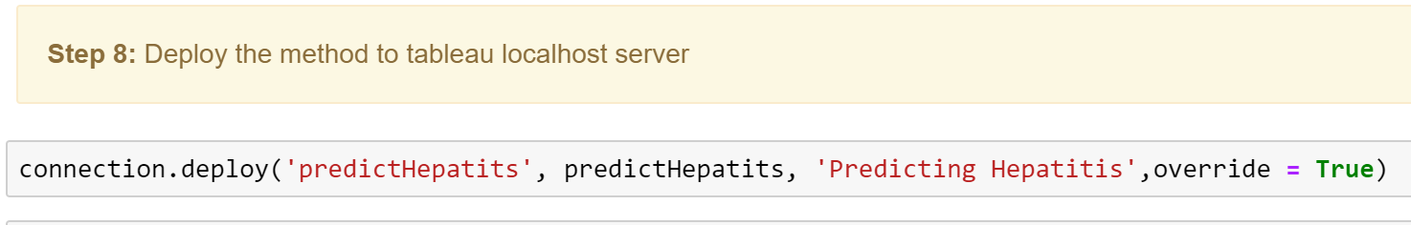
Integration provided by Tableau for Python ( using localhost server)
You can use a calculated field and call Python Code in it
You can also have your code in jupyter notebook or .py and invoke the method.
Deploy the code in localhost server
Interactive Viz
ML Algorithm
SVM
Tabpy
1 Layer NN
2 Layer DNN
Random Forest
< 92% Accuracy
+93% Accuracy

